Slide 1










BORING
BORING
ENGINEER
B
RING
ENGI
EER
ENG
NEER
B
RI
G
ENG
NEER
B
RI
G
ENG
NEER
B
RI
G
ENG
NEER
B
RI
G
ENG
NEER

Slide 2
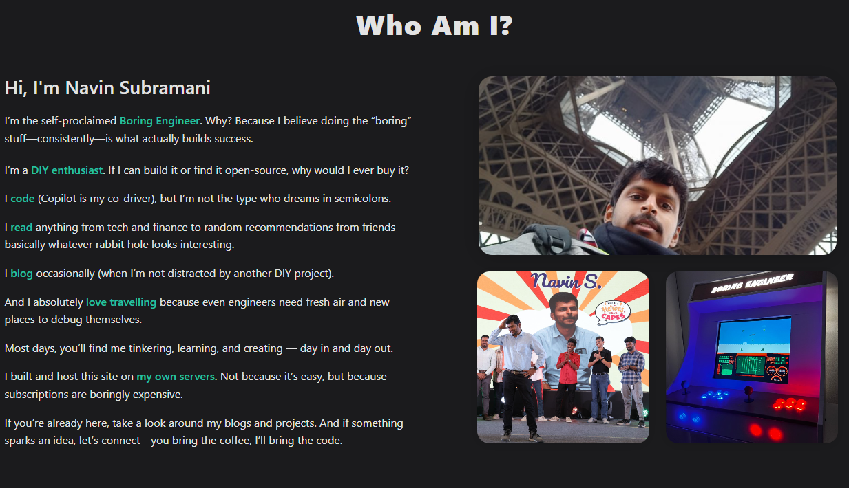







Personal site of Navin Subramani, where Navin blogs and shares his engineering, DIY experiences, travel and life.

Slide 3






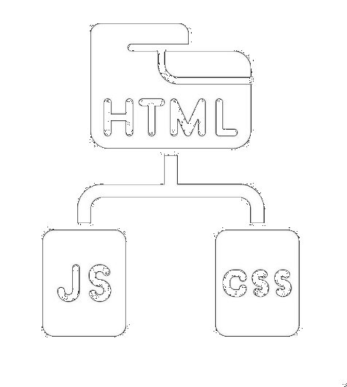


















Desktop
Web Stack
LabVIEW
TestStand
Python
React JS
Databases
Cloud
Home lab Stack
CI - CD
Ubuntu
Portainer
Azure
on-premise
Proxmox
Open Source
CLOUDFLARE
Hardwares
AI
National
Instruments
OpenAI
Ollama
Bedrock
LlamaIndex
Sensors & Actuators
Raspberry Pi
ollama

